Slide 1


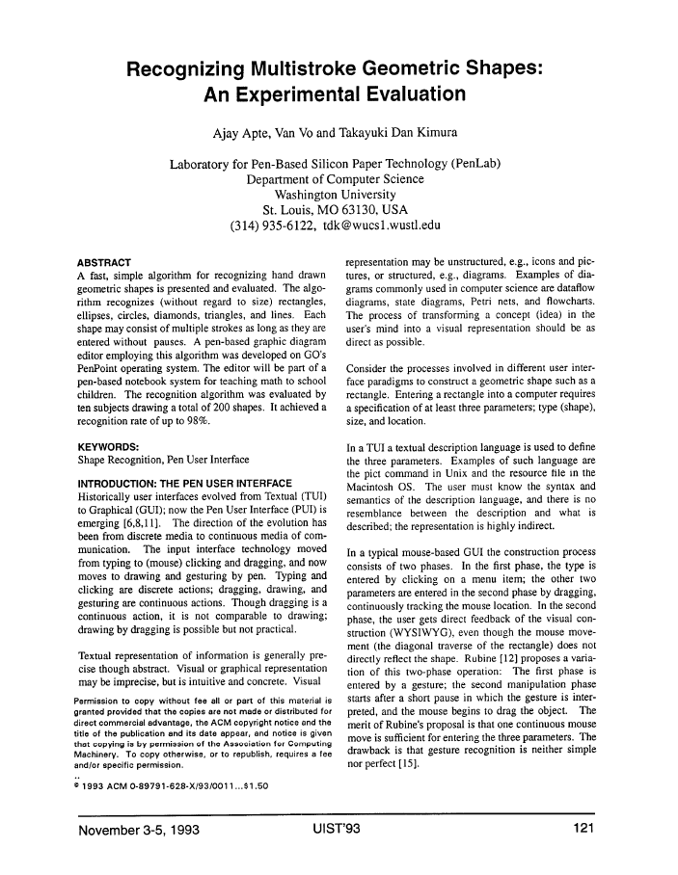

Recognizing Multistroke Geometric Shapes: An Experimental Evaluation
Work by Ajay Apte, Van Vo and Takayuki Dan Kimura Presentation by Beau De Clercq

Slide 2
Overview
Problem at hand
Solution
Details
Limitations
Experimentation
Example

Slide 3
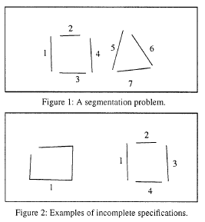
Problem at hand
Recognizing hand-drawn shapes
Segmentation
Incomplete specification
Stroke
Notes:
The problem at hand is the following: how do we recognise shapes from a set of segments drawn by a user?
This problem can be reduced to the following two questions: how can we determine what segments belong to the same shape (segmentation) and how can we handle shapes that aren’t closed (incomplete specification).
A stroke is defined as a set of data points containing only (X,Y) coordinates.

Slide 4
Solution
2 phase solution
Phase1: input
Phase2: edit
Segmentation?
Incomplete specification?
Notes:
The proposed solution is based on the work of Rubine and works in two phases.
In a first phase a user can draw strokes. When the user stops drawing for a certain amount of time the second phase starts where the drawing is interpreted and becomes dragable.
How does this solve the two problems mentioned earlier?
The segmentation problem is solved by using a variable length time out that depends on the length of the current stroke, the incomplete specification problem is solved by computing the convex hull of the collected strokes after sorting them in counter clockwise direction.

Slide 5
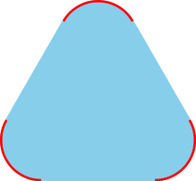
Solution
Convex hull
Geometric shape
Notes:
The convex hull of a shape is the smallest convex set that contains it and may be visualized as the shape enclosed by a rubber band stretched around the subset.
Computing the convex hull means constructing an unambiguous, efficient representation of the required convex shape.
Image: The convex hull of the red set is the blue and red convex set.

Slide 6
Details - general
Input
Store (X, Y) per point, set timer to 500+4n
Editing
Recognition
Geometry
Filters
Notes:
So how does this solution work?
First a user draws any number of strokes. Once the users lets the timer expire we enter the editing phase.
In the editing phase an object is selected by single tap gesture. A selected object is recognized by the selection handles drawn at its corners. It can be resized, moved, deleted, or copied to the buffer and pasted.
The shape recognition algorithm is based on two ideas.
First, because shapes are geometric entities, they should be recognizable solely by their geometry. No stroke information (i.e., order of input data points, speed of
input) is used for analysis; only data points are used. Second, recognition can be achieved by filtering. Each filter categorizes input according to certain criteria.

Slide 7
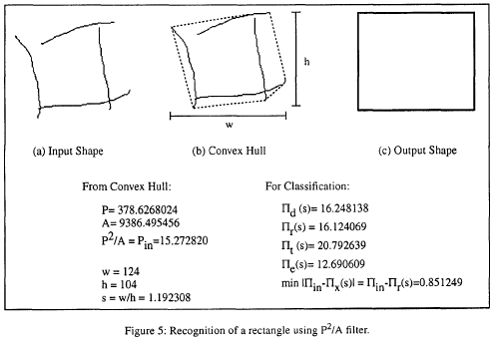
Details - recognition
Setup
Compute convex hull, perimeter and area
Filtering
Area-Ratio Filter, Triangle-Diamond Filter, P²/A Ratio Filter, …
Notes:
Each shape employs vwious filters. Each filter is weighted according to its success in recognizing that shape.
For triangles and diamonds, the area-ratio and triangle-diamond filters are used. For circles and lines, only the P2/A ratio filter is used. And for rectangles and ellipses, the area-ratio and P2/A ratio filters are used.
The weighted outputs are combined to select the final shape.

Slide 8
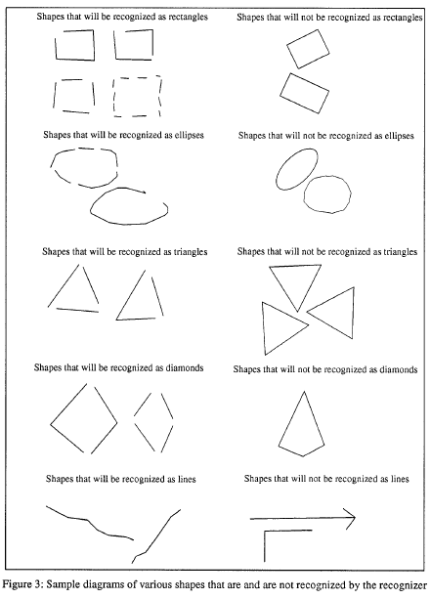
Limitations
z

Slide 9
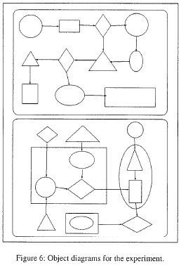
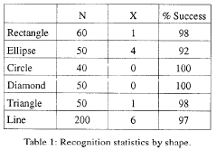

Experimentation
Ten subjects drew following diagram

Slide 10
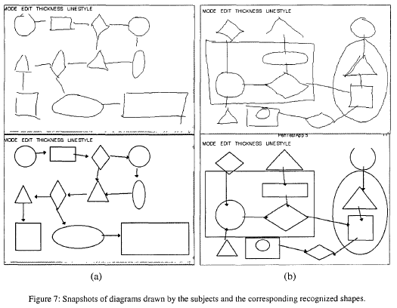
Example

